Slide 1


Computer-Aided Design RTL Methodology
Mahdi Aminian
Some slides courtesy of:
“Hardware Systems Modeling”, A. Vachoux, EPFL
CAD slides from Dr. Saheb Zamani

Slide 2
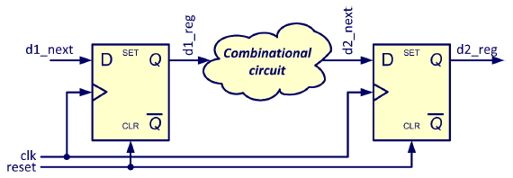
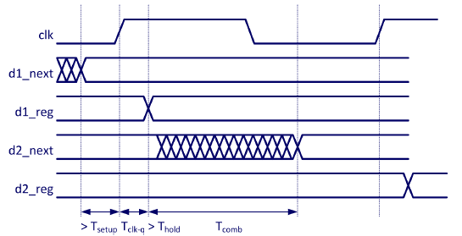
Synchronous Design

Slide 3
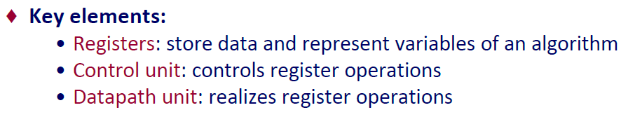
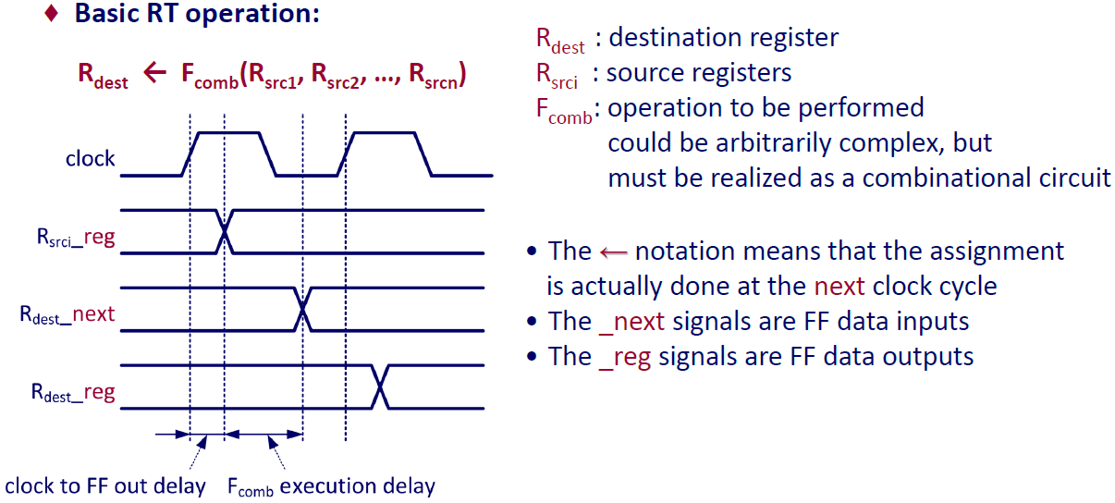
Register Transfer Methodology

Slide 4
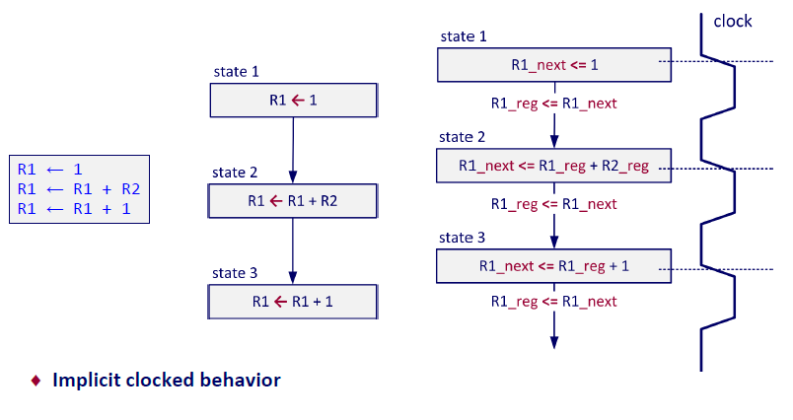
Abstract RT Graph

Slide 5
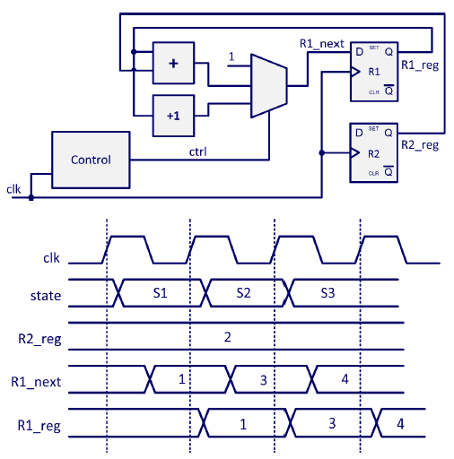
RT Block & Timing Diagram

Slide 6
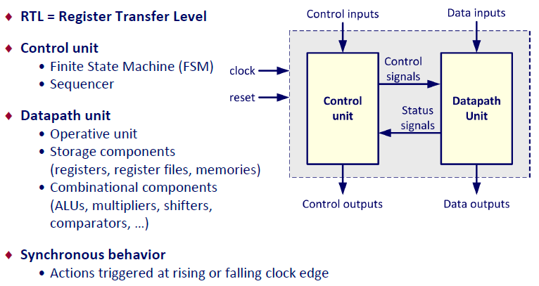
Generic RTL Architecture

Slide 7
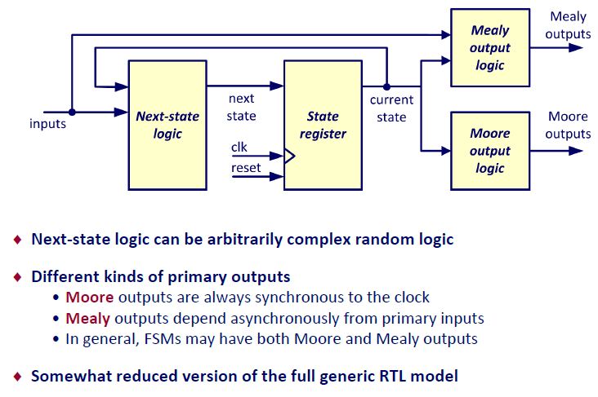
Finite State Machine

Slide 8
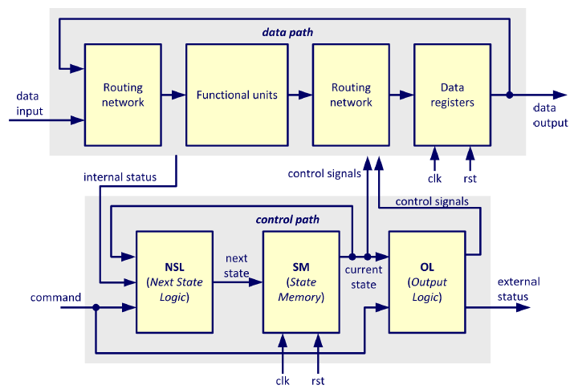
RTL Architecture FSM + Datapath (FSMD)

Slide 9
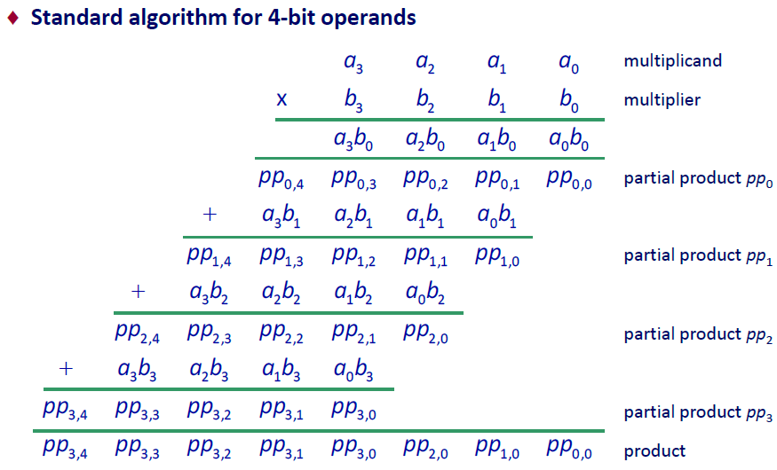
Example: 8-bit Repetitive-Addition Multiplier

Slide 10
Example: 8-bit Repetitive-Addition Multiplier

Slide 11
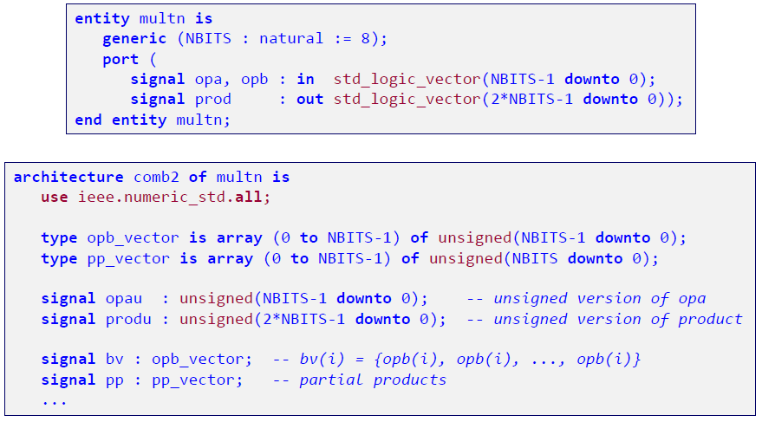
Combination Implementation

Slide 12
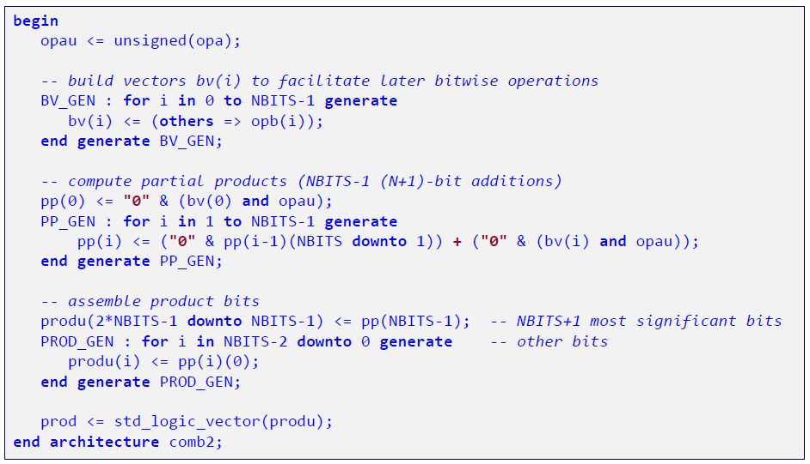
Combination Implementation

Slide 13
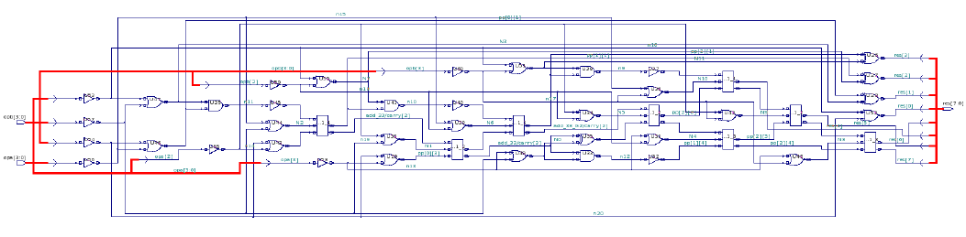
Comb. 4-bit Multiplier

Slide 14
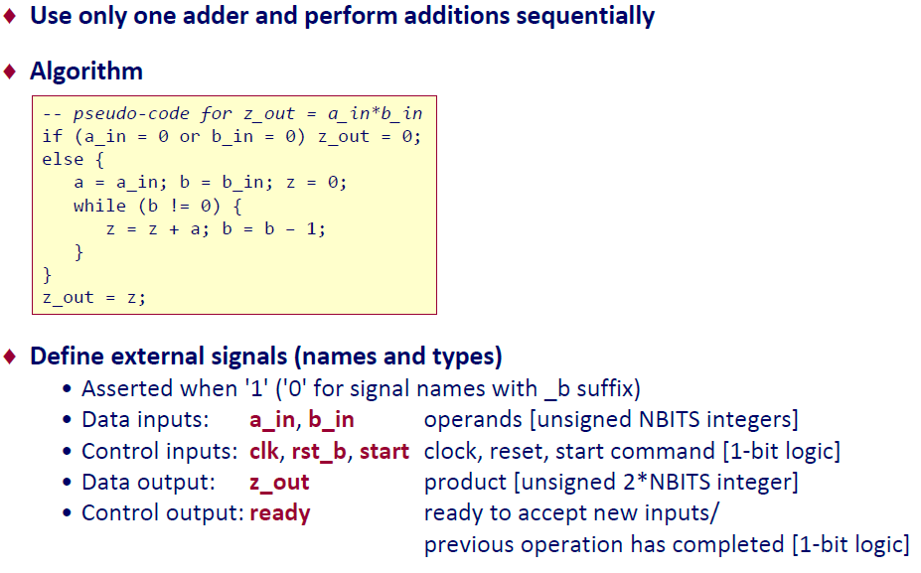
FSMD Implementation

Slide 15
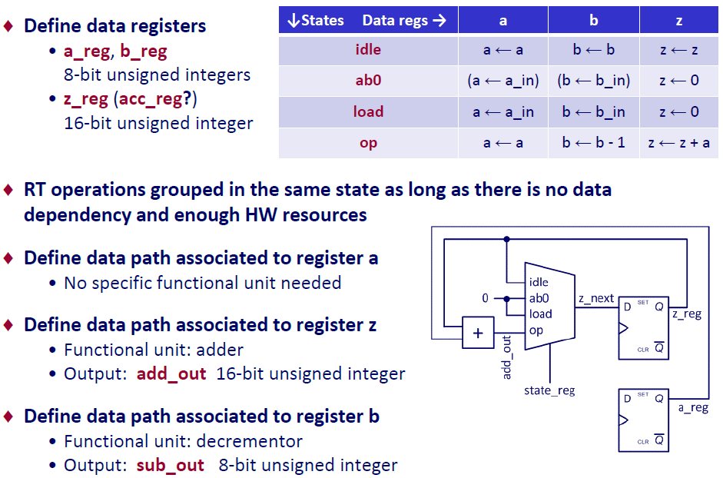
FSMD Implementation

Slide 16
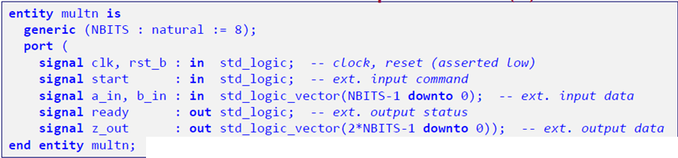
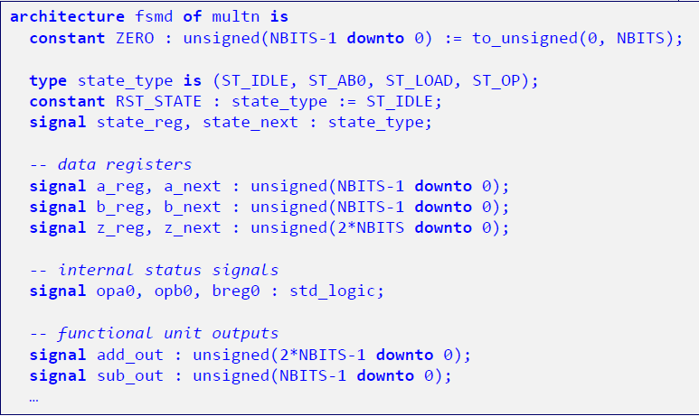
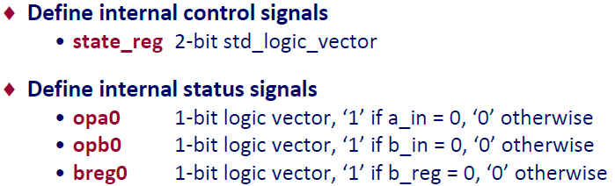
FSMD Implementation

Slide 17
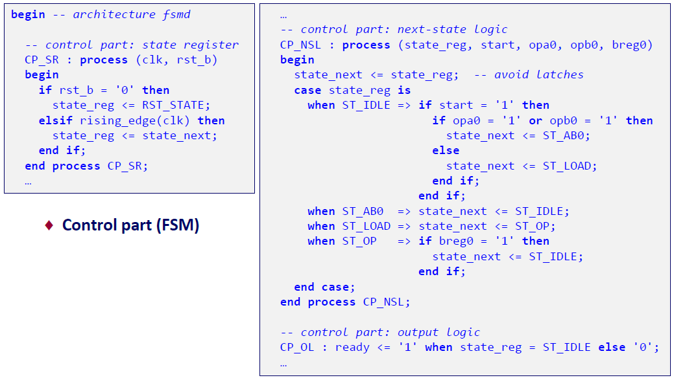
FSMD Implementation

Slide 18
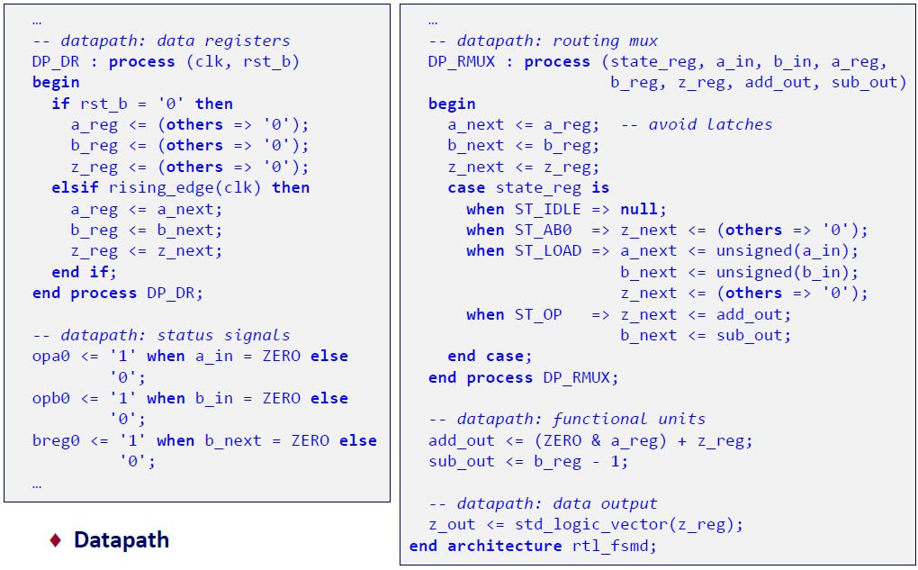
FSMD Implementation

